Slide 1
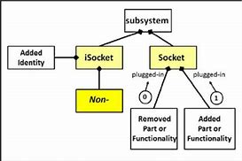
What is subsystem?
Group of interconnected and interactive parts that performs an important job or task as a component of a larger system.

Slide 2
Linux Subsystem

Slide 3
Types of Memory Pool
Private memory pools
Shared memory pools
Special Shared Pools :
*MACHINE
*BASE
General Shared Pools :
*INTERACT
*SPOOL
*SHRPOOL1

Slide 4
Unix File System
What is file?
An ordinary file is a file on the system that contains data, text, or program instructions. In this tutorial, you look at working with ordinary files.
What is directory?
Directories store both special and ordinary files. For users familiar with Windows or Mac OS, Unix directories are equivalent to folders.

Slide 5
What is Linux File System?
Linux File System or any file system generally is a layer which is under the operating system that handles the positioning of your data on the storage, without it; the system cannot knows which file starts from where and ends where.

Slide 6
Types of Linux File System
EXT2
EXT3
EXT4
ISOFS
SYSFS
PROCFS

Slide 7
Disk Arrangement

